Slide 1
Healthy food

Slide 2
My opinion
I eat normally. I eat vegetables, meat , fruits and milk products.
I try avoid junk food but sometimes i give to me something sweet

Slide 3
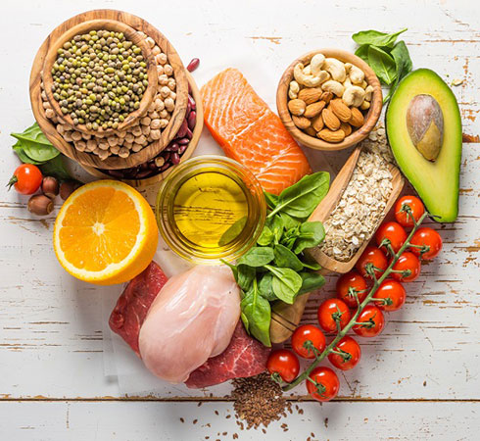
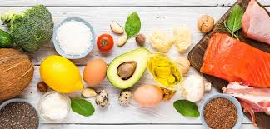

Slide 4
Vegetarianism
Vegetarianism is the practice of abstaining from the consumption of meat (red meat, poultry, seafood, and the flesh of any other animal), and may also include abstention from by-products of animal slaughter.

Slide 5
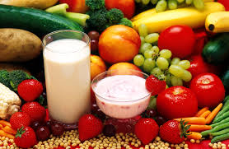
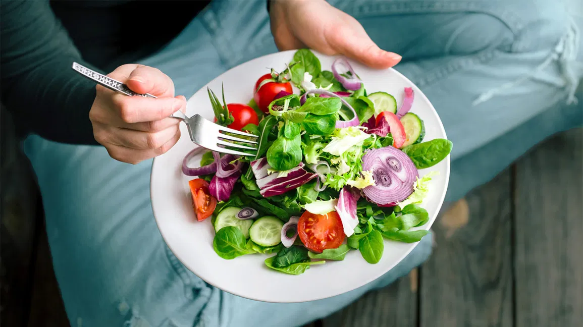
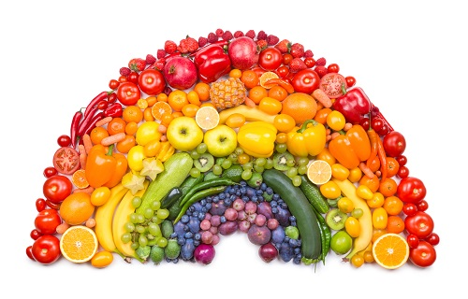

Slide 6
Veganism
Veganism is the practice of abstaining from the use of animal products, particularly in diet, and an associated philosophy that rejects the commodity status of animals.Dietary vegans, also known as "strict vegetarians", refrain from consuming meat, eggs, dairy products, and any other animal-derived substances.

Slide 7
